Slide 1
Tutorial 1 CSCI369
Daryl Low 7349026
Eugene Sim 7058883
Yang Tao 7023273

Slide 2
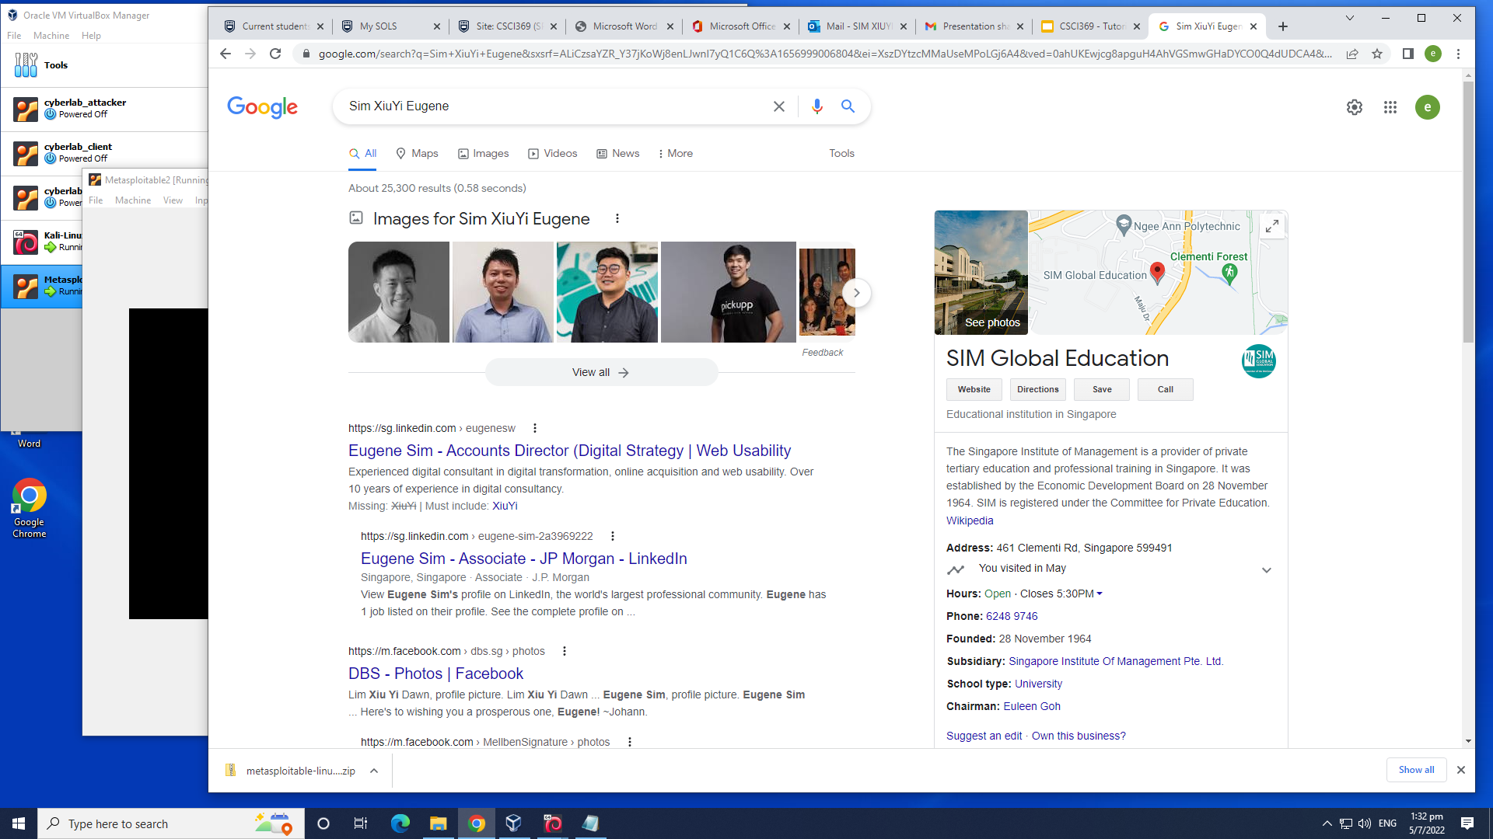
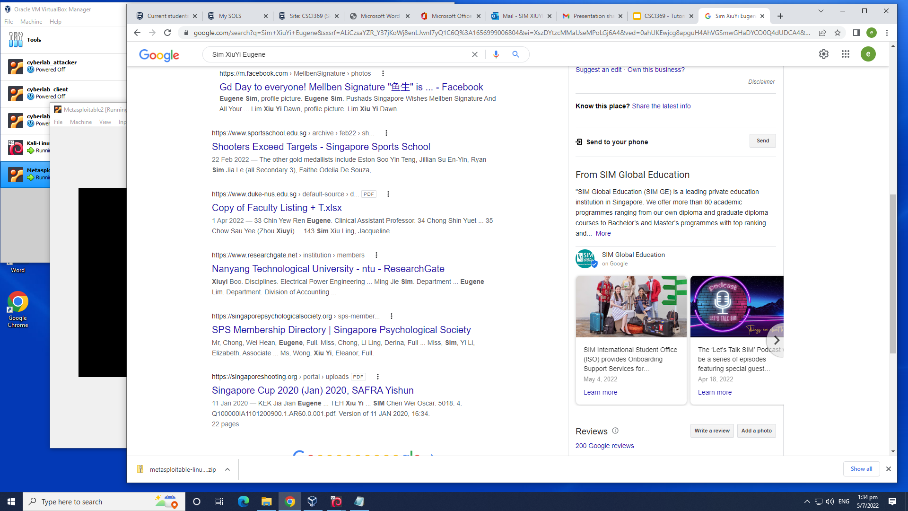
Ego Search Eugene Sim
v
I am comfortable with the search result since narrowing down to a person with a common name would be tedious

Slide 3
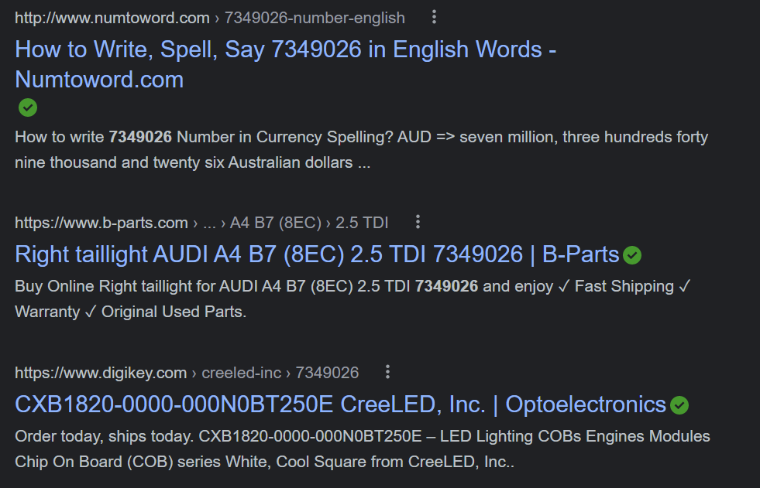
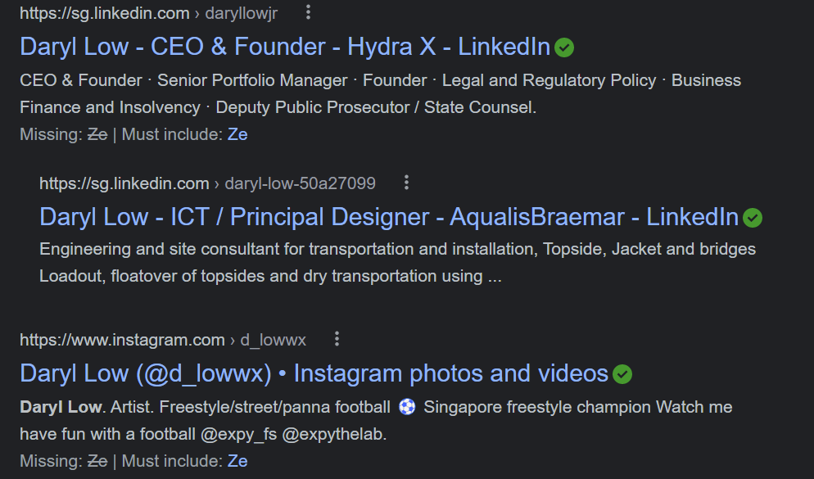
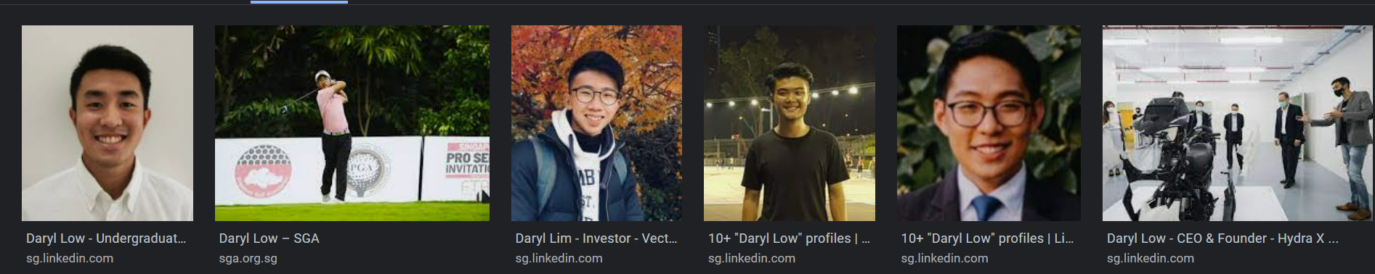
Ego Search Daryl Low
I am comfortable with the google results as there are many famous people with the same name as me. However under the image sections, there are pictures of my face from linkedIn.

Slide 4
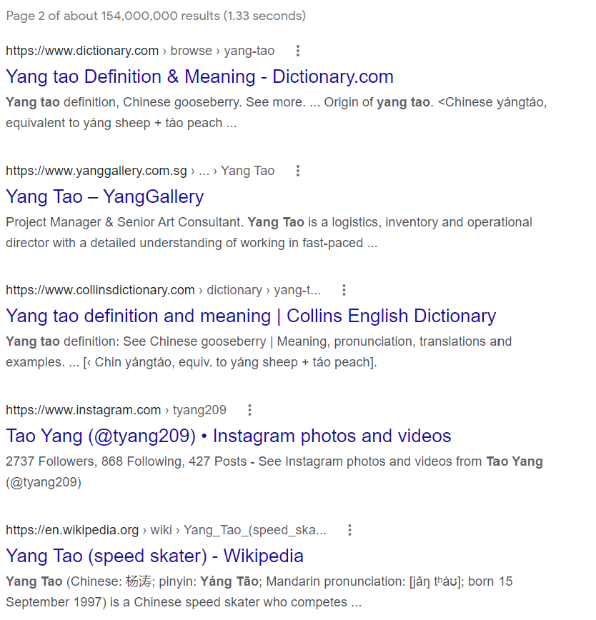
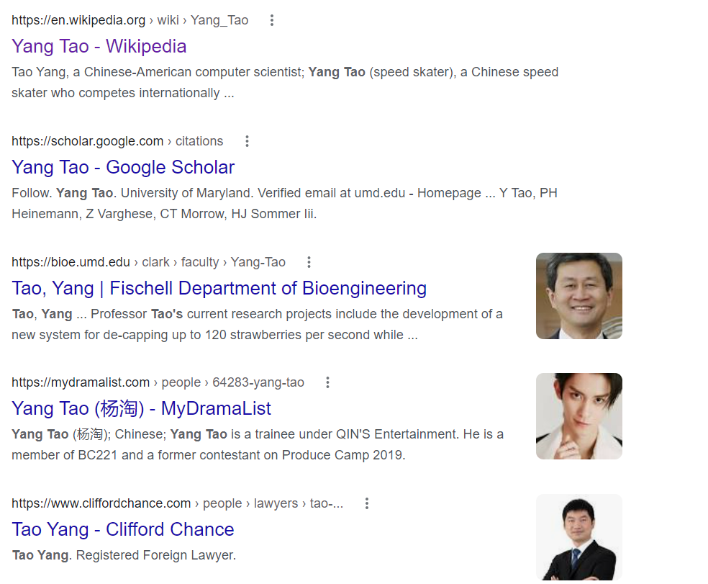
Ego-Search Yang Tao
I am comfortable with the result shown, as there are quite a few of famous people that have the same name.

